Slide 1

Oyster River
Aquaculture proposals
Public hearing August 20th, 2019
Fish & Game region 3 office in Durham
3 proposals
90 people attended
9am -1pm

Slide 2
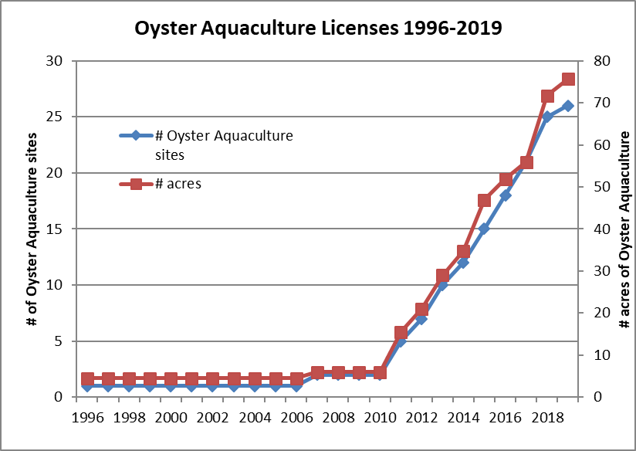

Slide 3
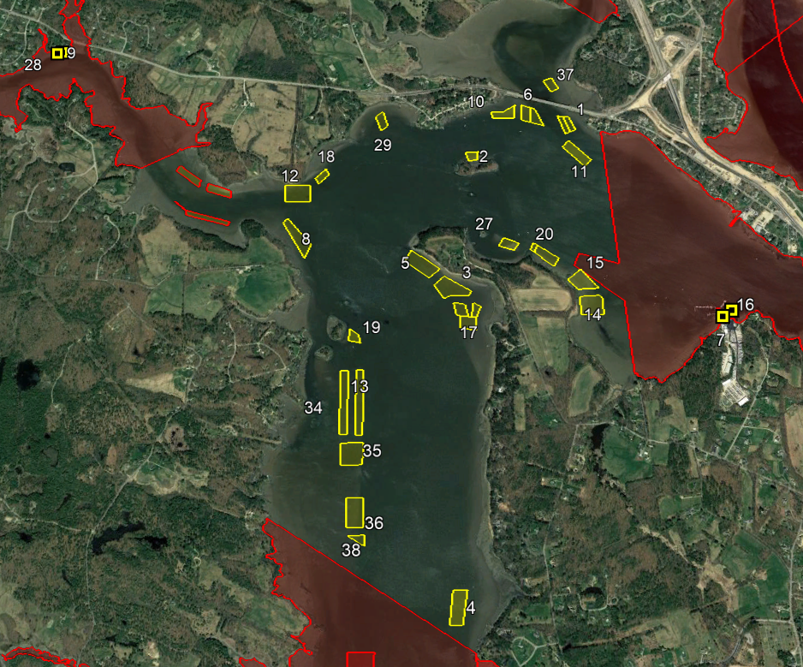
Oyster Aquaculture in Little Bay
24 oyster sites in Little Bay (all bottom culture)
4 upwellers (2 in the Oyster River and 2 at Great Bay Marine)
Harvest
Year | # oysters harvested | # Businessess with harvest | Value
2018 | 439,497 | 11 | $311,039
2017 | 329,156 | 10 | $246,441
2016 | 184,832 | 8 | $128,843
2015 | 207,024 | 11 | $144,312
2014 | 164,965 | 8 | $114,994
2013 | 81,274 | 4 | $56,654

Slide 4
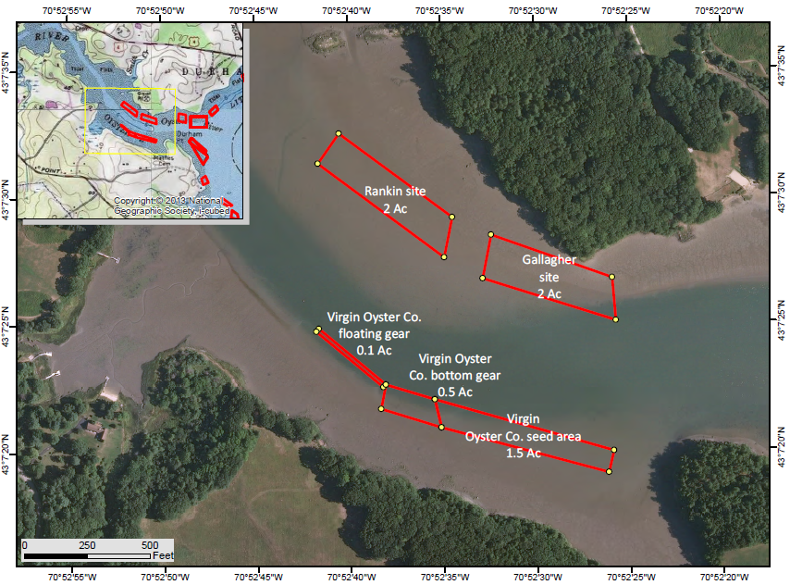
Oyster River
3 applications
Christopher Gallagher of Little Bay Beauties
  2-acre site
  bottom culture
  Oysters, northern quahogs, soft shelled clams, and razor clams
Joseph Rankin of Hidden Coast Shellfish
  2-acre site
  bottom/suspended culture
  Oysters
Brian Gennaco of Virgin Oyster Company
  2.1-acre site
  bottom/suspended culture
  Oysters, northern quahogs, soft shelled clams, and razor clams

Slide 5
Proposed Aquaculture Gear
Types of Gear
  No gear (planting oysters directly onto substrate)
  Trays
  Mesh Bags
  Cages
  Floating gear (Oyster Gros)
Christopher Gallagher of Little Bay Beauties
  Bottom seeding
  Trays (30” x 36” x 16”)
  Stacking Trays/Cages (30” x 36” x 16”)
Joseph Rankin of Hidden Coast Shellfish
  OysterGros (Floating gear) 3’ x 5’ x 2’
  Trays (3’ x 4’ x 6”)
  Cages
Brian Gennaco of Virgin Oyster Company
  OysterGros (Floating gear) 3’ x 5’ x 2’
  Cages (3’ x 4’ x 21”)
  Bottom seeding

Slide 6
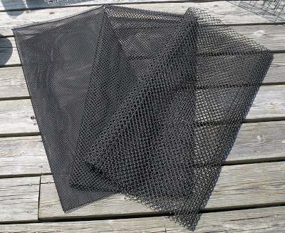
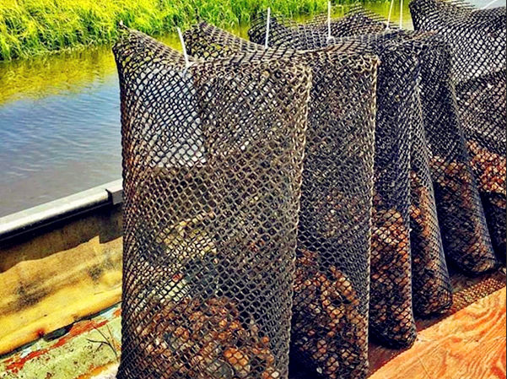
Mesh bags

Slide 7
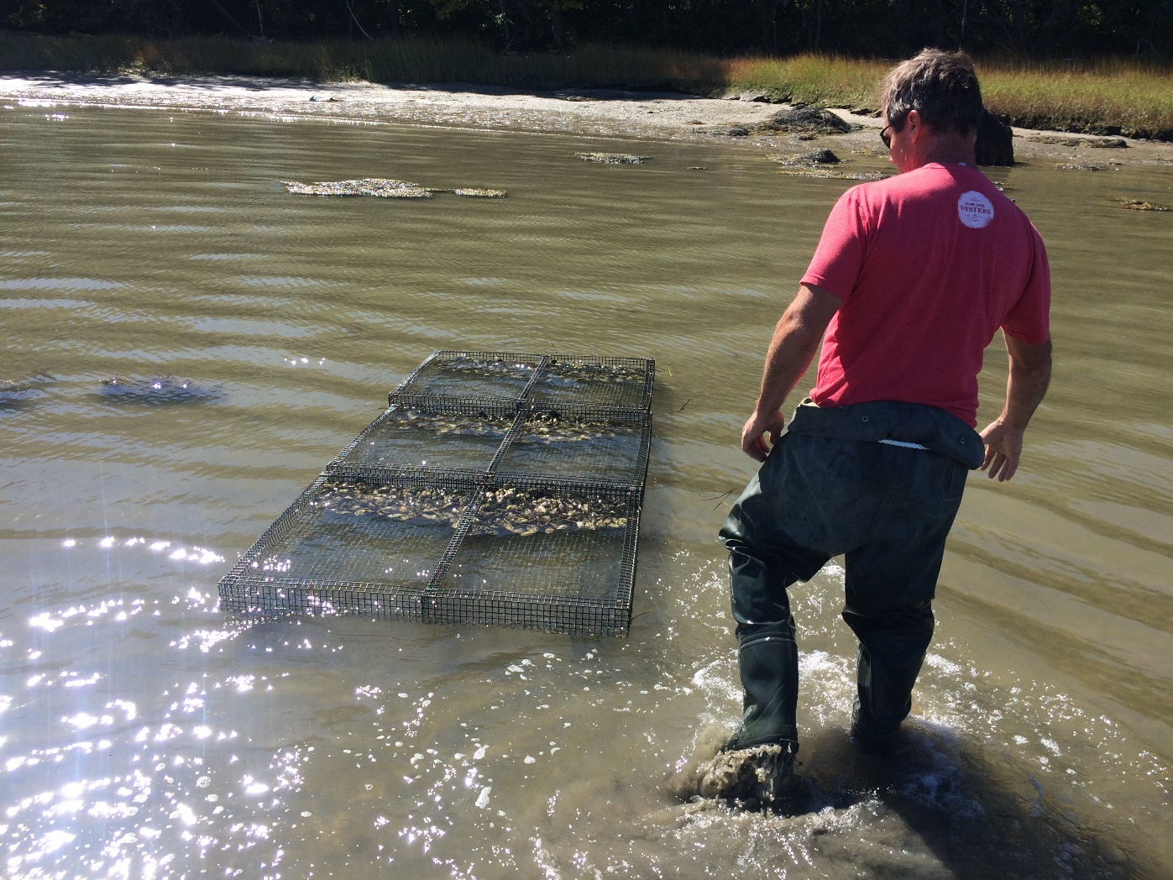
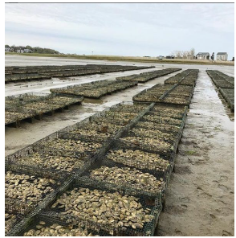
Trays

Slide 8
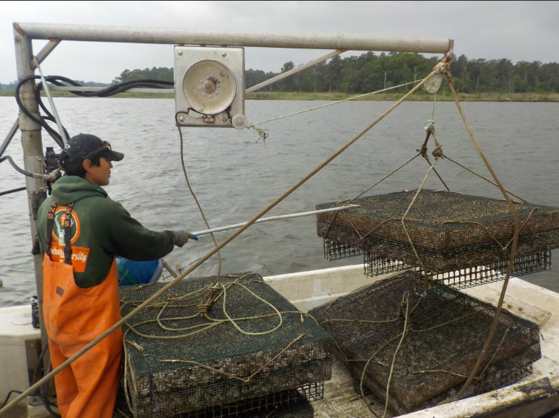
Trays

Slide 9
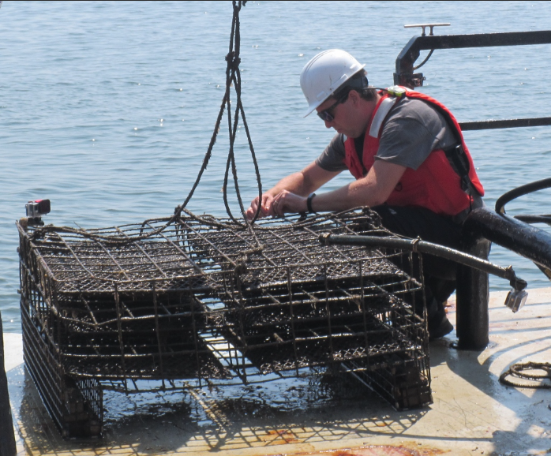
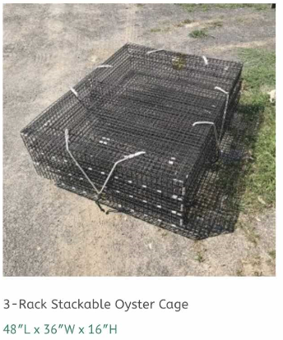
Cages

Slide 10
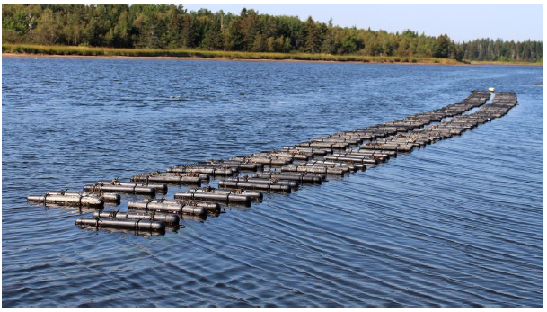
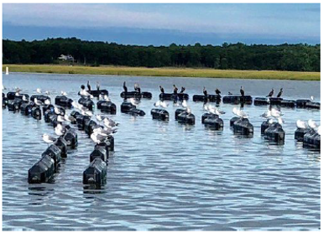
Floating Gear

Slide 11
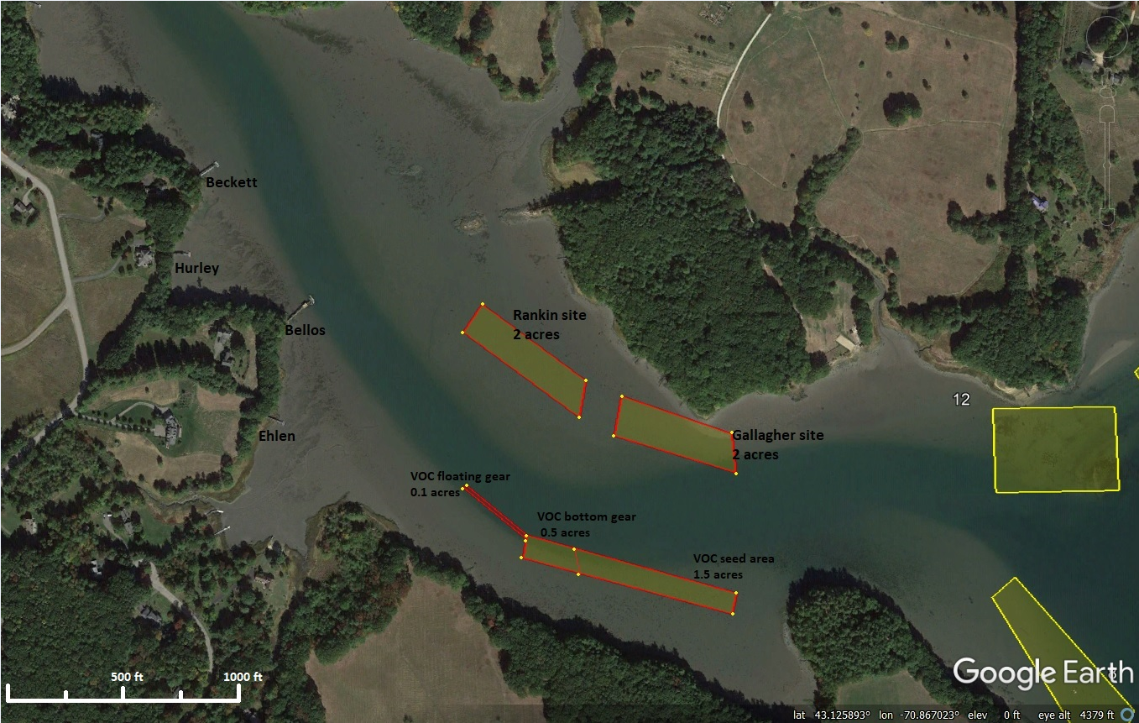

Slide 12
Fish and Game rules used to determine if a site should be licensed
Fis 807.07(j) The executive director shall review all of the information to determine that the proposed aquaculture operation would not pose any unacceptable risk as specified in Fis 807.02(g), does not conflict with or negatively impact any recreational, commercial or other use currently being conducted in the area in and around the proposed project area, or does not adversely impact the value or use of private property in and around the projected area before issuing a license.
Fis 807.02(g) Unacceptable risk shall be determined by considering any negative impact the aquaculture operation would have on persons, the environment, indigenous aquatic or marine species using the following criteria:
(1) The proposed species:
a. Life cycle;
b. Life history;
c. Reproductive habits; and
d. Habitat requirements;
(2) Genetics of the individual wildlife;
(3) Interaction with competing species;
(4) Food/habitat competition with indigenous species; and
(5) Other factors relating to the proposed operation such as:
a. Types of system, whether closed or controlled, and
b. Screened outlets or other enclosures.

Slide 13
Public comments
Bird watching
Boating/ navigation
Canoeing
Community usage vs exclusive for 3 people
Do not want to see gear in water
UNH rowing
Enjoy natural beauty
Fishing
Jet skiing
Kayaking
Noises
Paddle boarding
Poorly designed proposals
Protection from wind
Lack of business plans
Property values will be impacted
Raft up in Cove
Recreational activities
Sailing
Salt marsh restoration project impacts
Steel cages can damage boast
Support aquaculture, but not here
Swimming
Surface buoys
Tubing
Waterskiing

Slide 14
Fis 807.07(j) The executive director shall review all of the information to determine that the proposed aquaculture operation would not pose any unacceptable risk as specified in Fis 807.02(g), does not conflict with or negatively impact any recreational, commercial or other use currently being conducted in the area in and around the proposed project area, or does not adversely impact the value or use of private property in and around the projected area before issuing a license.

Slide 15
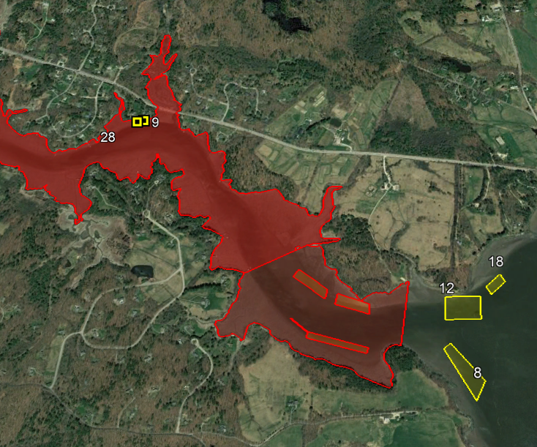

Slide 16
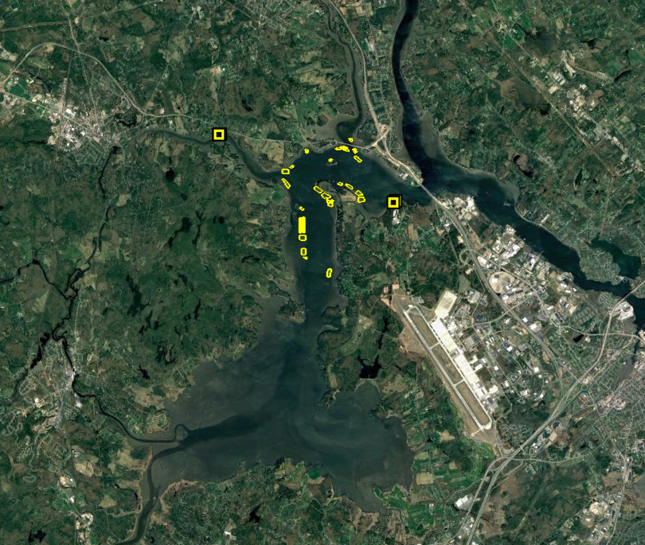

Slide 17
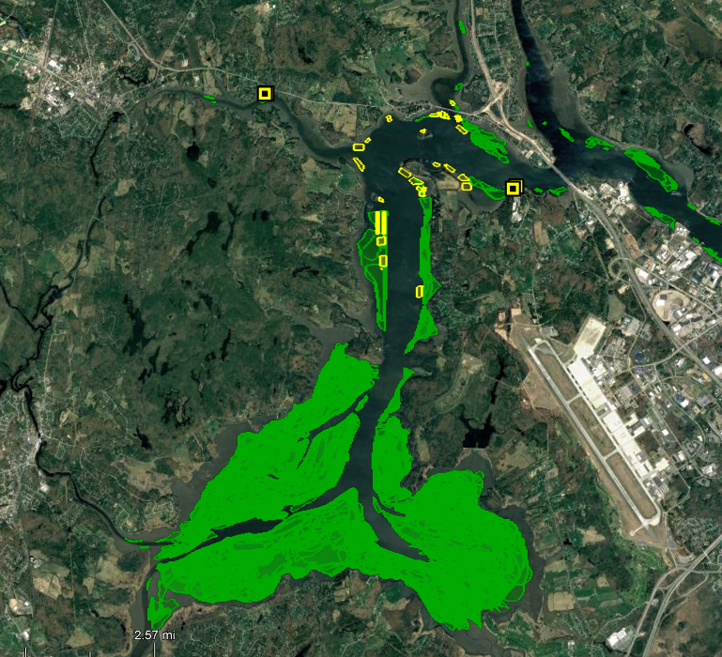
Eel grass
1981 - 2018

Slide 18
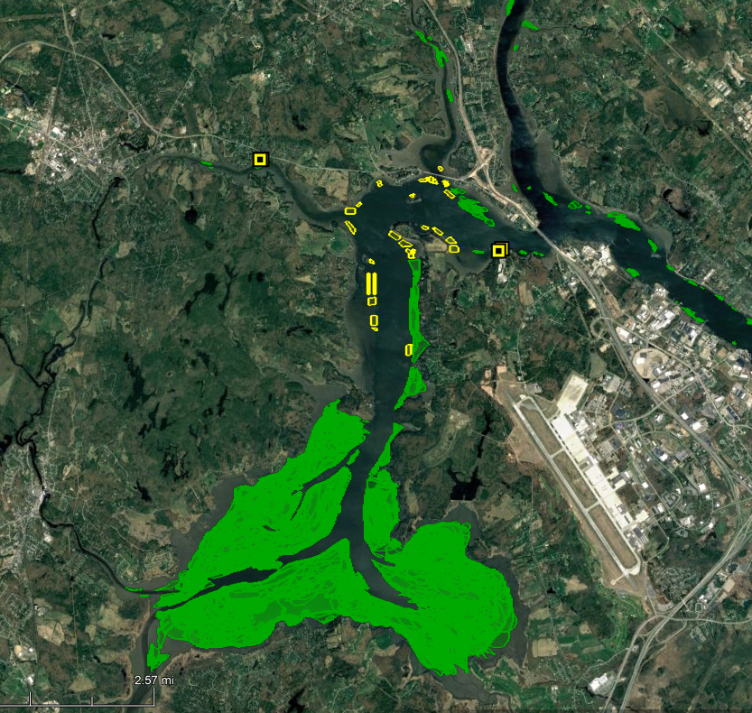
Eel grass
2001 - 2018

