Slide 1
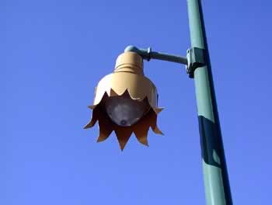
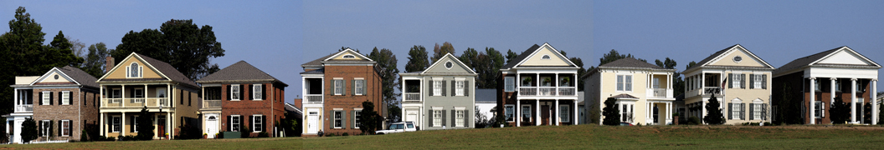
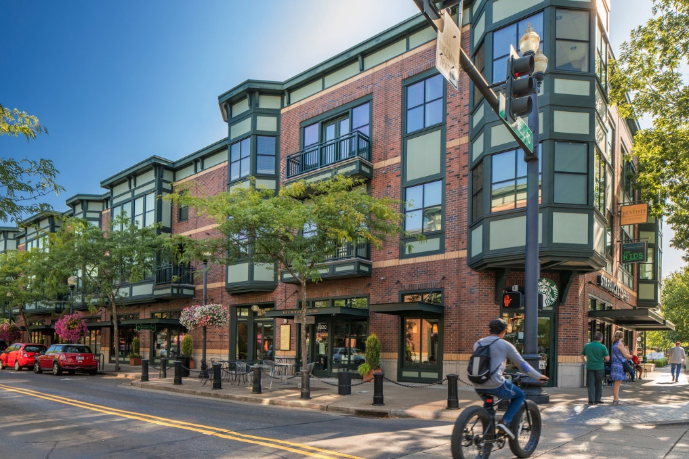
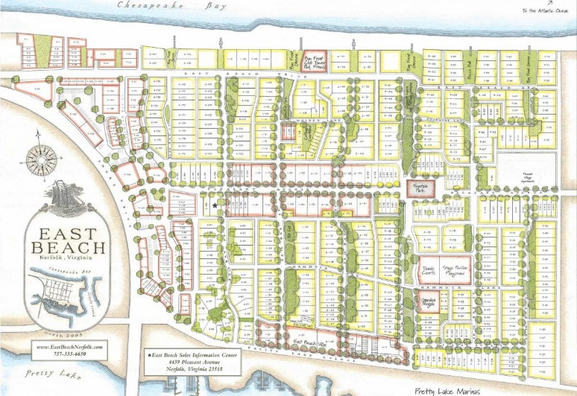
Planned Unit Developments
Presentation to Durham Planning Board
October 11, 2023
(by Town Planner Michael Behrendt)

Slide 2
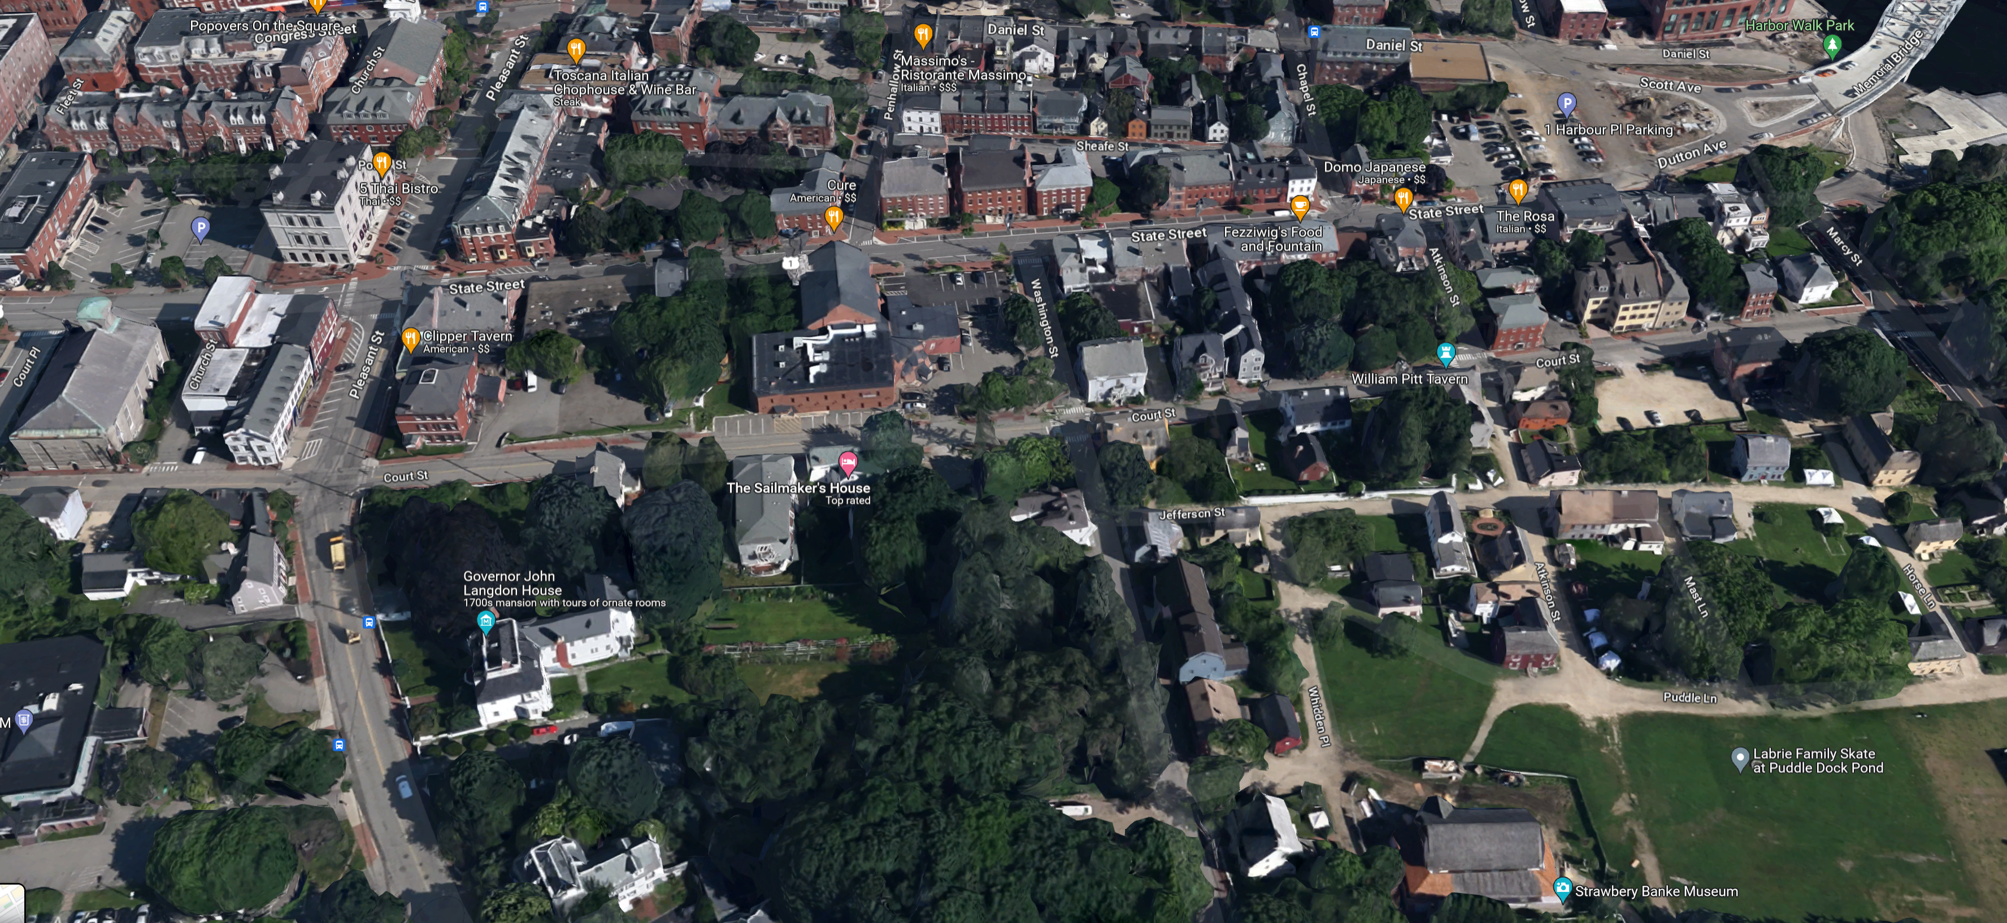

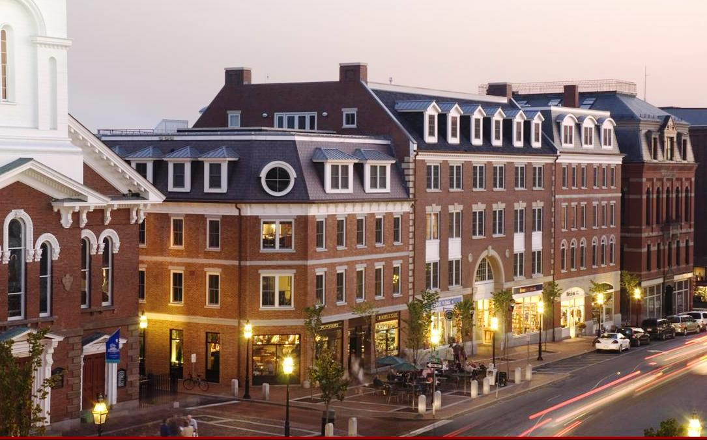
Traditional Mixed Use – Portsmouth
Walkable and Interesting = Much Appeal + Value

Slide 3
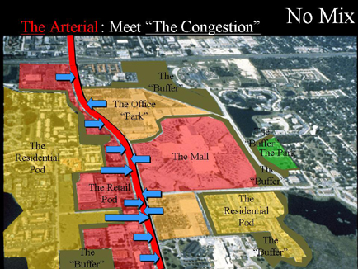
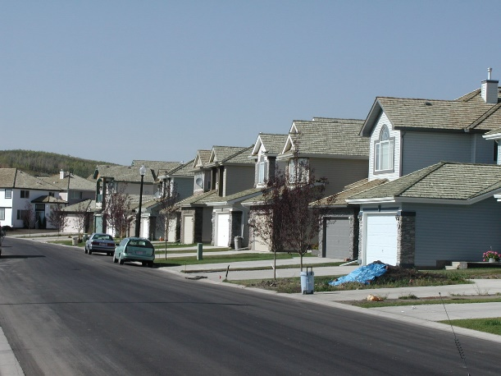
Mixed Use Today – Everything Separated
Not Walkable and Boring

Slide 4
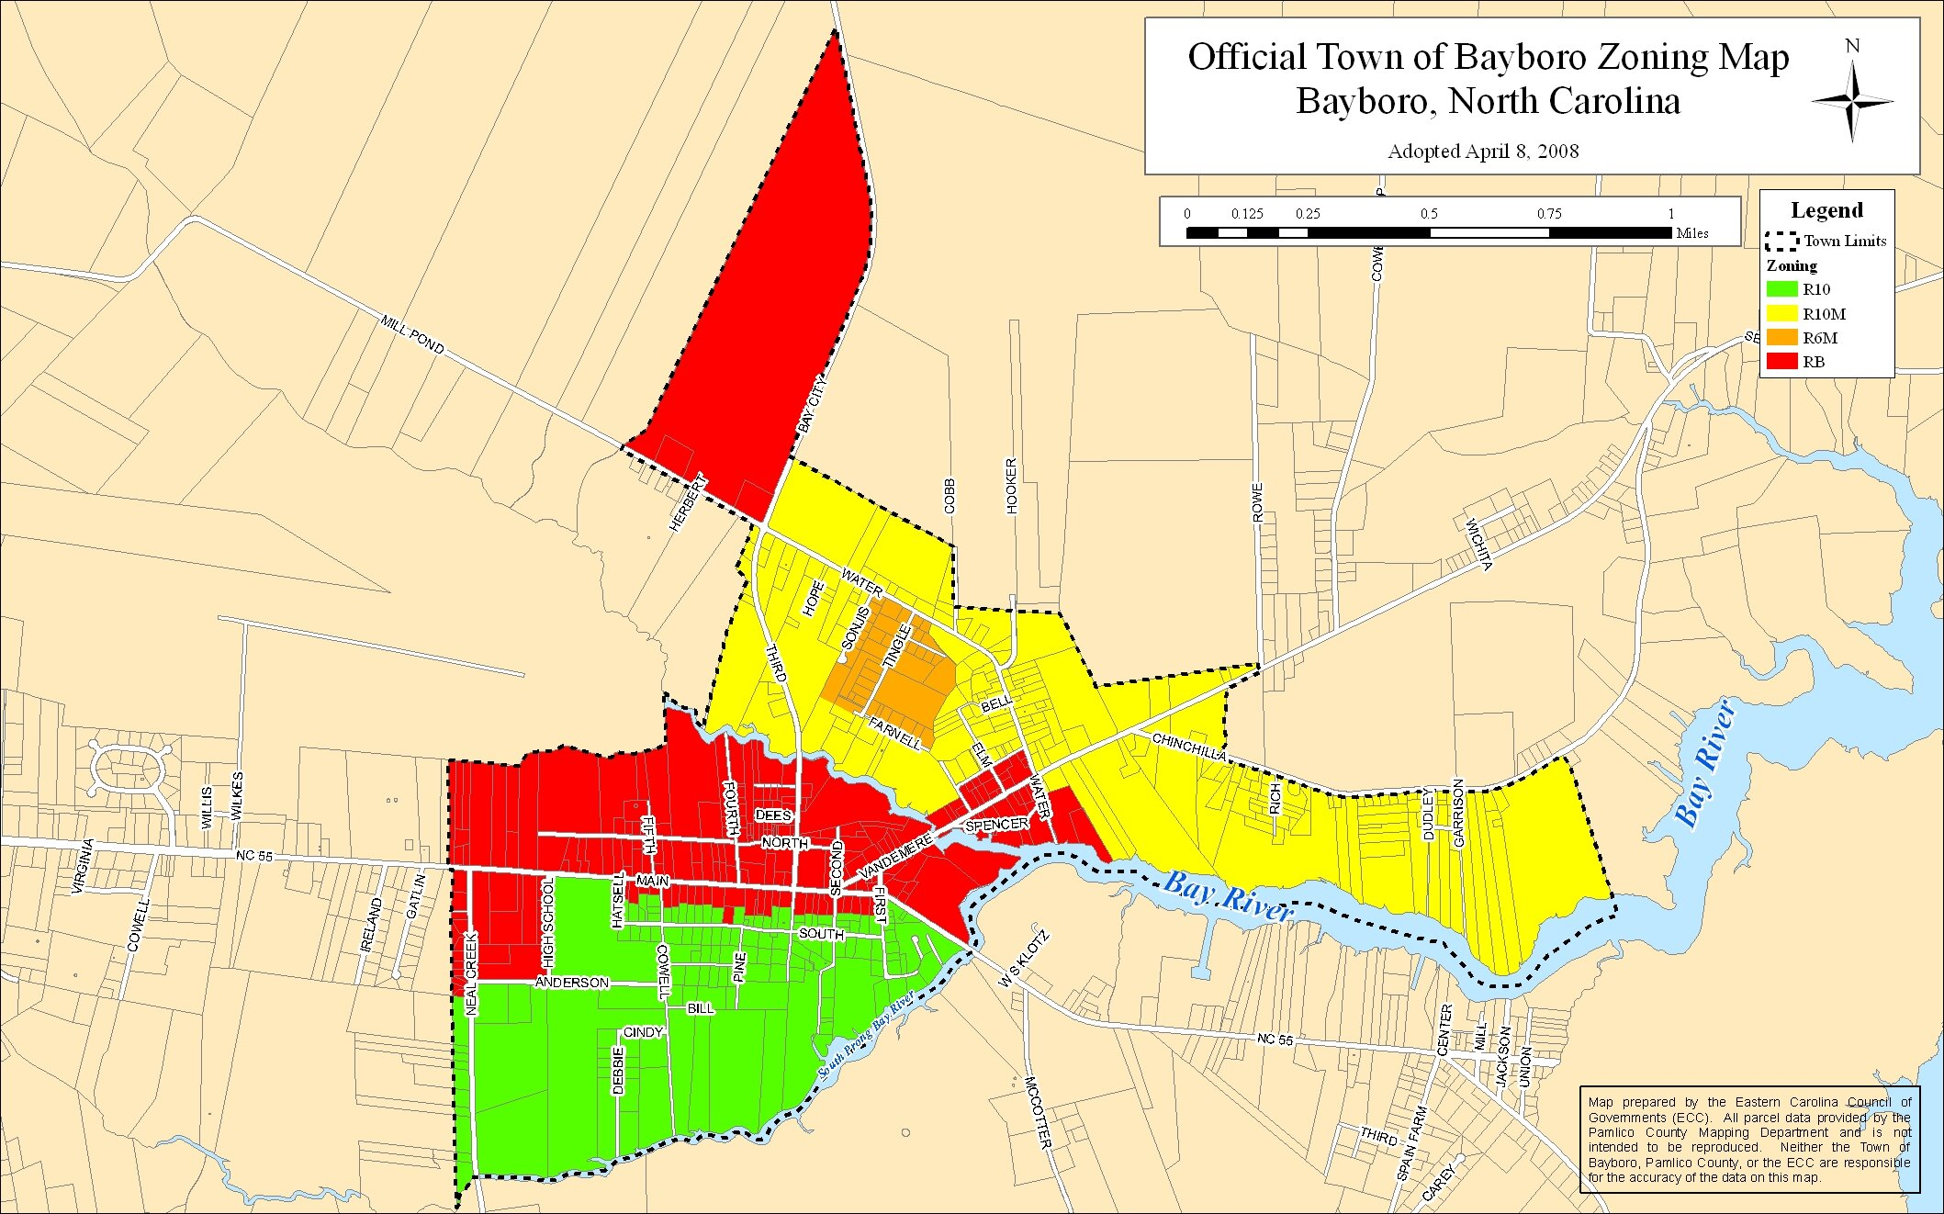
Zoning Today – Everything Separated

Slide 5


Omelette = Mixed Use
Or just the ingredients

Slide 6
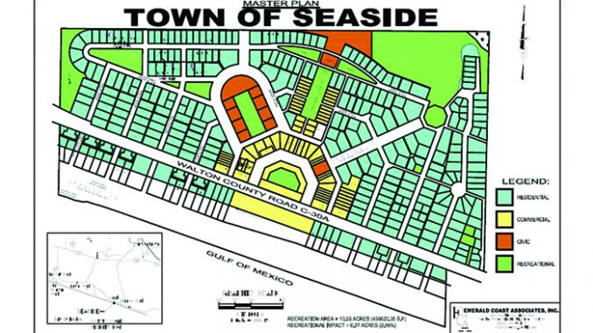
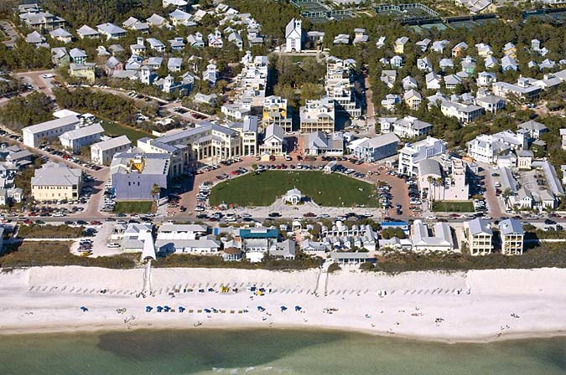
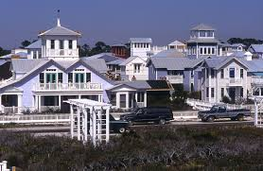
Seaside
Florida

Slide 7
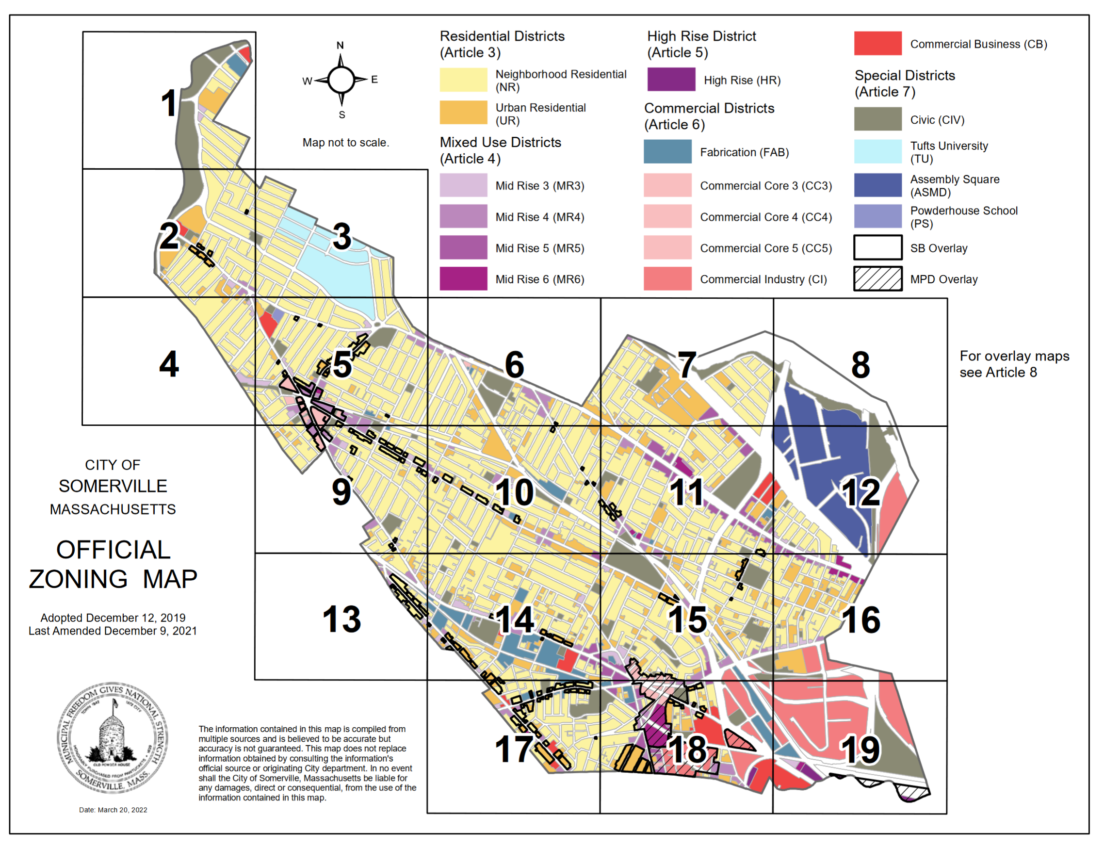
Somerville, MA – Zoning Map
A Form-Based Code

Slide 8
What is a PUD (Planned Unit Development)?
Conventional zoning separates types of uses by district. It is not effective for promoting high-quality mixed-use development.
A PUD allows for innovative, carefully designed, mixed-use development on a large parcel.
A PUD allows a landowner to propose their own plan largely independent of zoning requirements otherwise applicable.
A PUD specifies its own uses, density, setbacks, heights, and other design parameters.
A PUD functions as a special zoning designation for a particular tract of land.
A PUD incorporates: a) drawings showing how the site will be developed; and b) a narrative plan.
A PUD for a large site should be a superior to what could be developed under conventional zoning.
A PUD should yield significant benefits for a landowner and for the community. They get density and flexibility; the community gets excellent design.
Good design is the key!
*** There is great discretion for the Town in whether or not to approve a PUD. If the Town thinks the PUD will not be beneficial then it can be readily rejected.

Slide 9
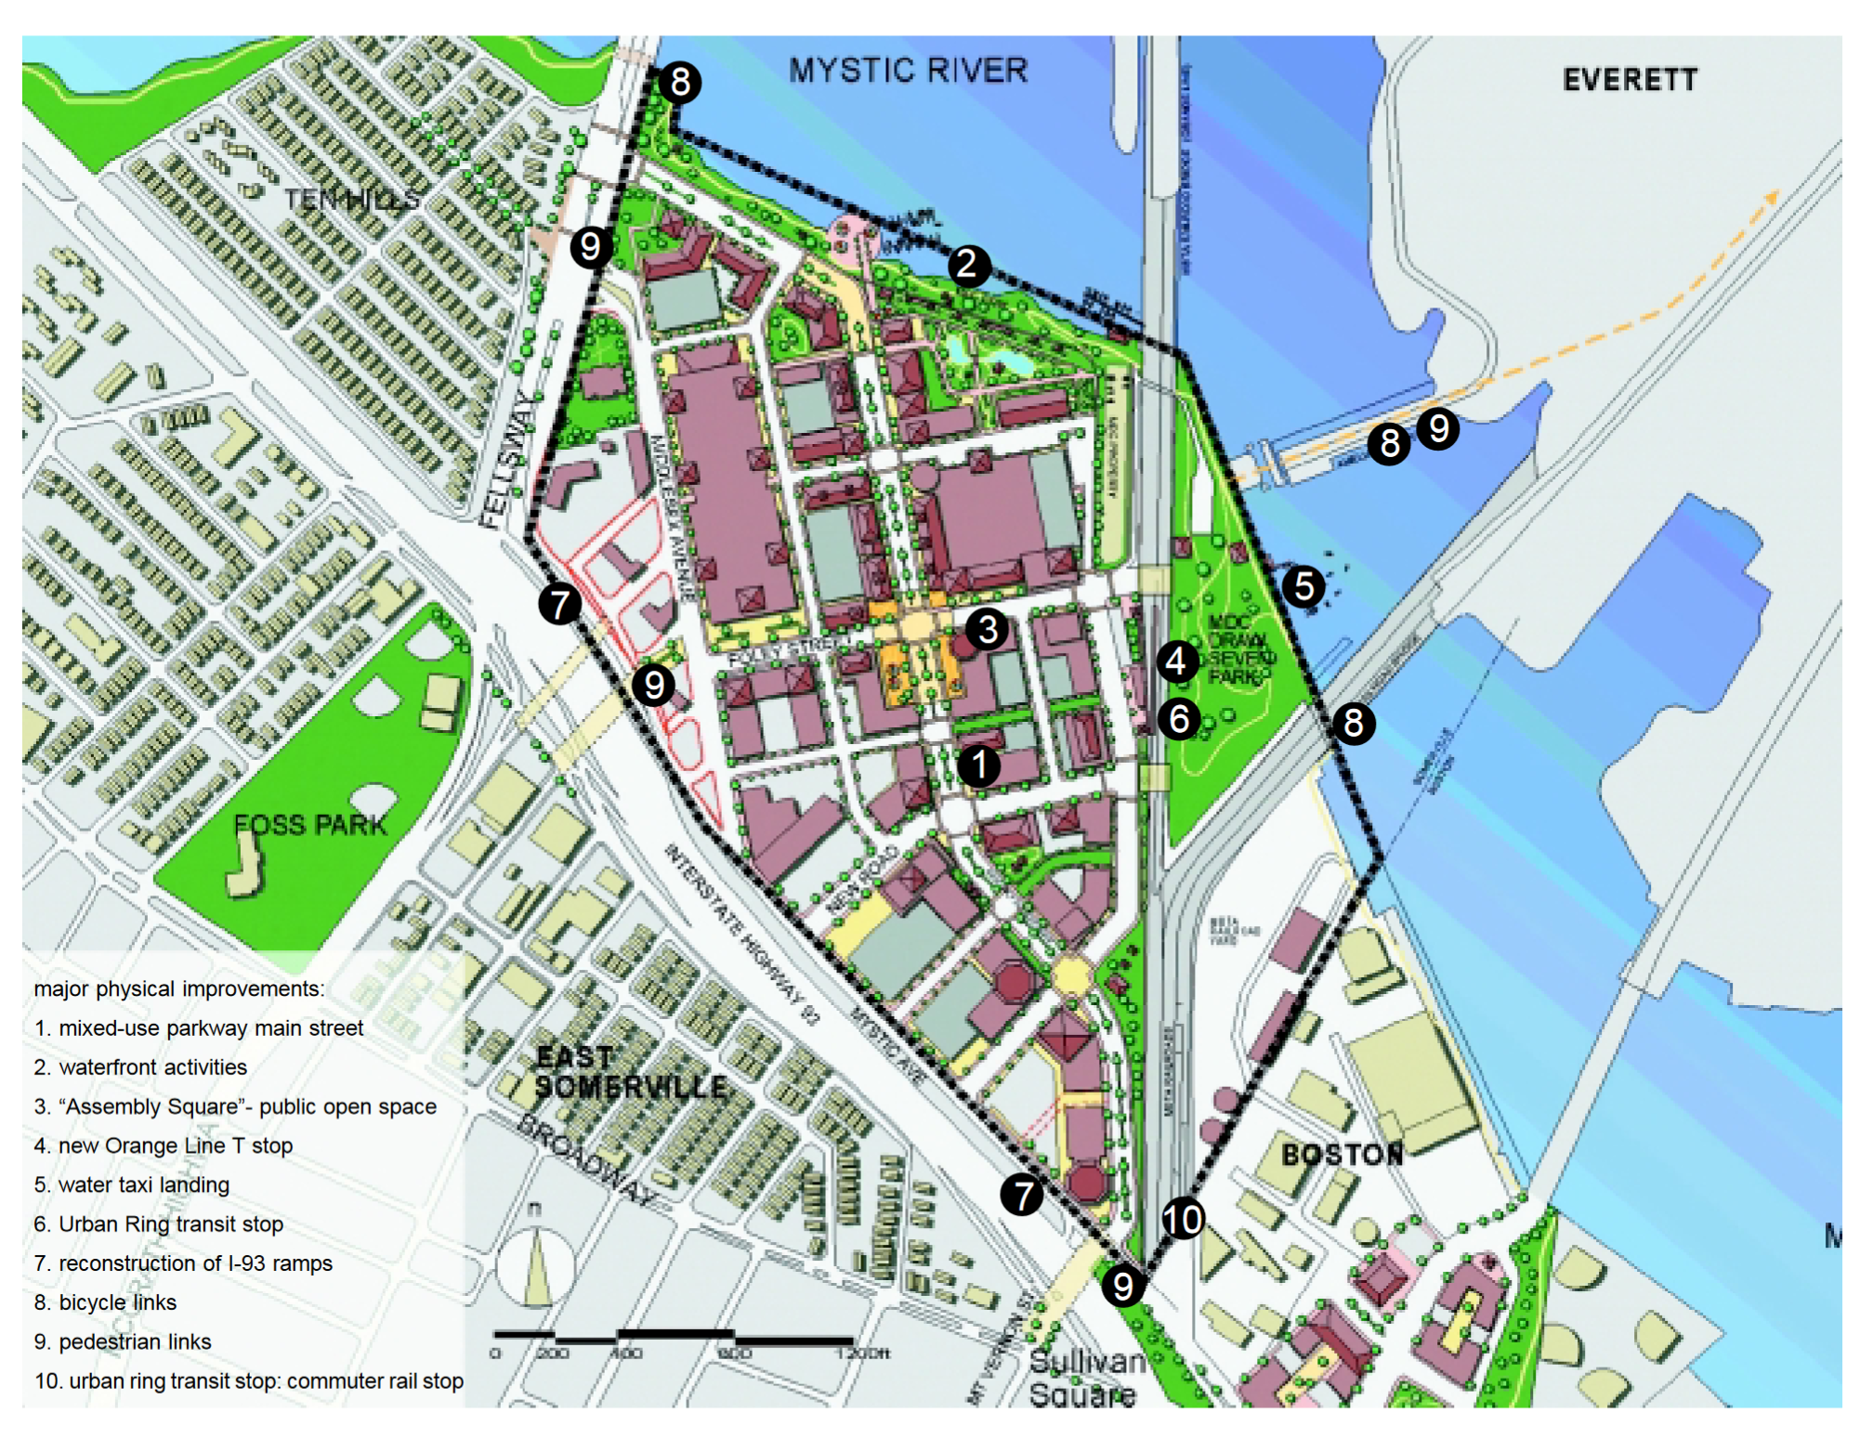
Assembly Square - Master Plan
Contiguous parcels totaling 66.5 acres
2,100 residential units (condos and apartments)
450,000 square feet of retail and restaurant
1.7 million square feet of office
62,000 square foot cinema
200-room hotel
26.5% gross open space
15% usable open space
No maximum density
No minimum setbacks
No minimum frontage
Architectural standards
Landscaping standards
Lighting standards

Slide 10
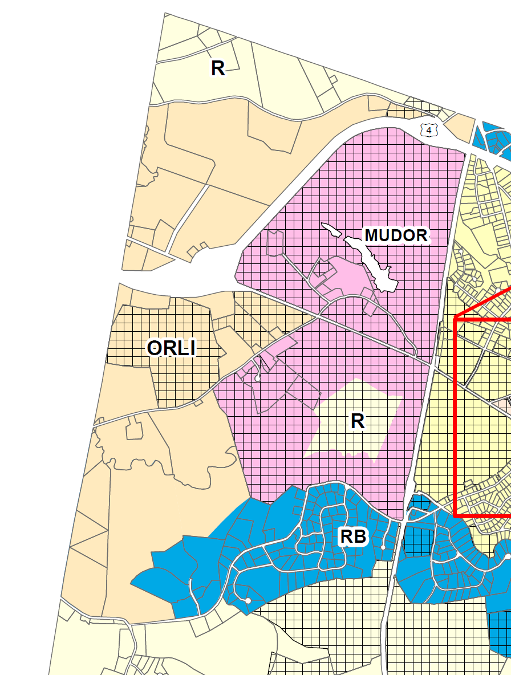
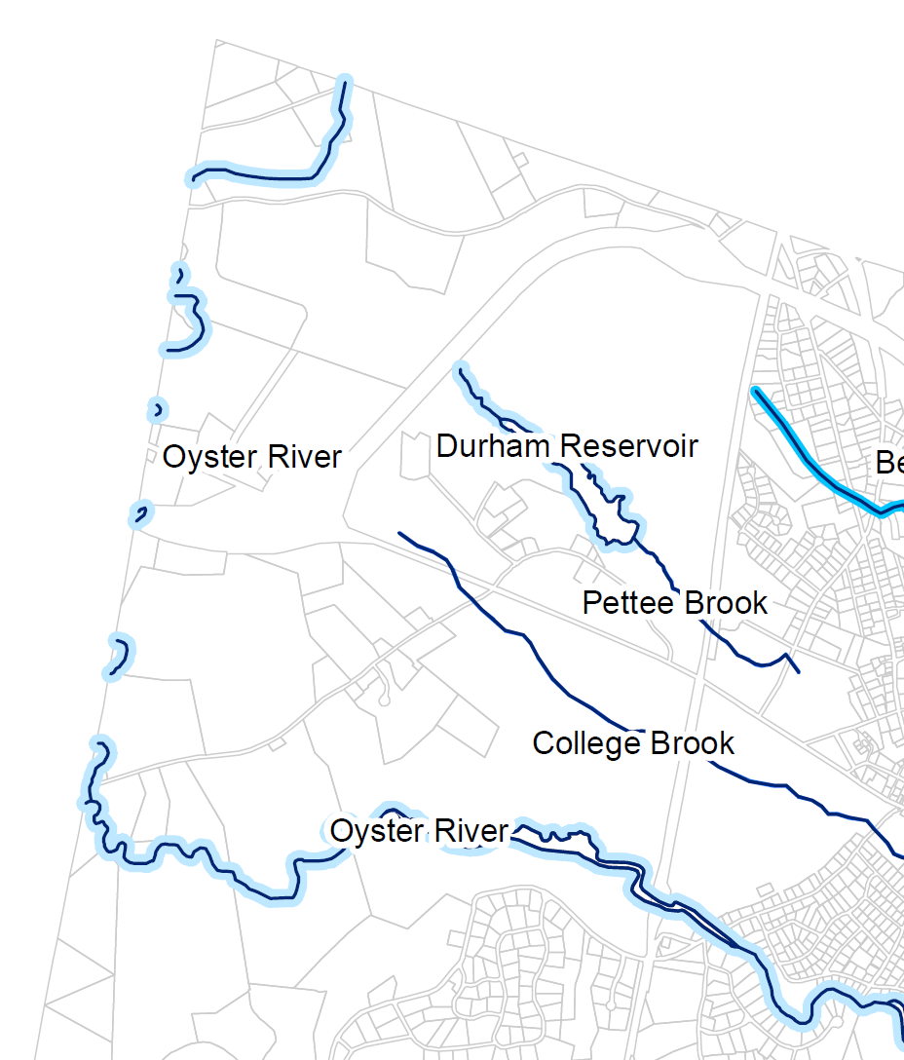
Some Possible Basic Requirements
Location: Allowed only in the ORLI and MUDOR zoning districts.
Parcel Size: Minimum of 25 acres under unified control.
Utilities: Must use Town water and sewer.
Uses: Must include mix of uses – residential, retail, restaurant, office, hotel, light industry, agriculture.
Open Space: Must have a minimum of 25% open space.
Components: Must include detailed plans for architecture, landscaping, pedestrian ways, lighting, street furniture, focal points, etc.

Slide 11
Criteria for Review of Proposals
The Town Council and Planning Board shall determine in their sole discretion if the proposal generally meets these criteria and is worthy of the special consideration afforded a Planned Unit Development. The proposed PUD:
conforms with the intent, requirements, and objectives of this article.
incorporates a general standard of excellence, including architecture, site layout, landscaping, provision of open space, etc.
incorporates elements of traditional neighborhood developments.
is harmonious in design.
is walkable, in accordance with best planning practices.
incorporates special elements and focal points to cause delight and surprise.
provides a strong positive benefit to Durham.
Is consistent with the Town of Durham Master Plan, particularly the Land Use Chapter.
is generally consistent with the eight conditional use criteria.
and…

Slide 12
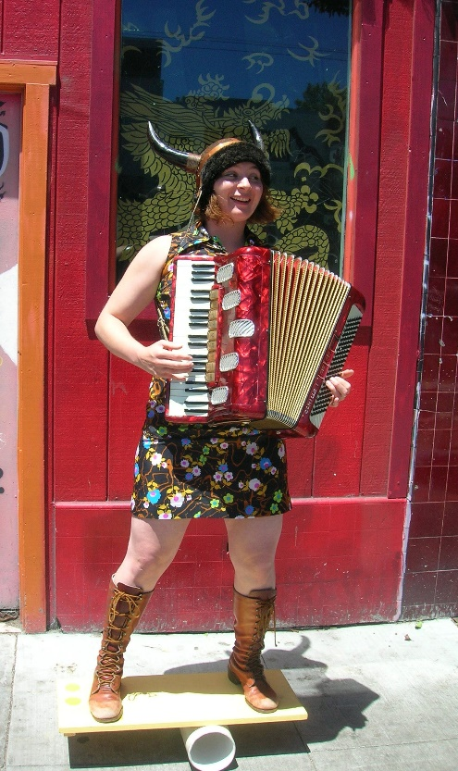
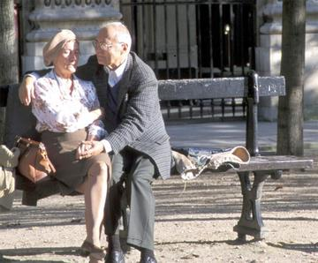

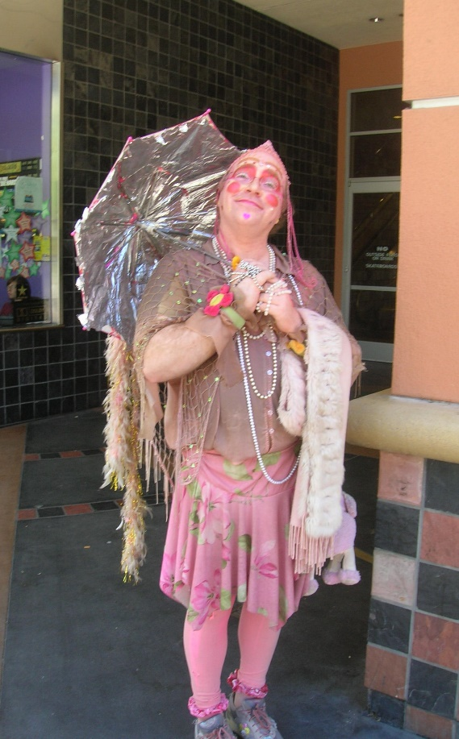
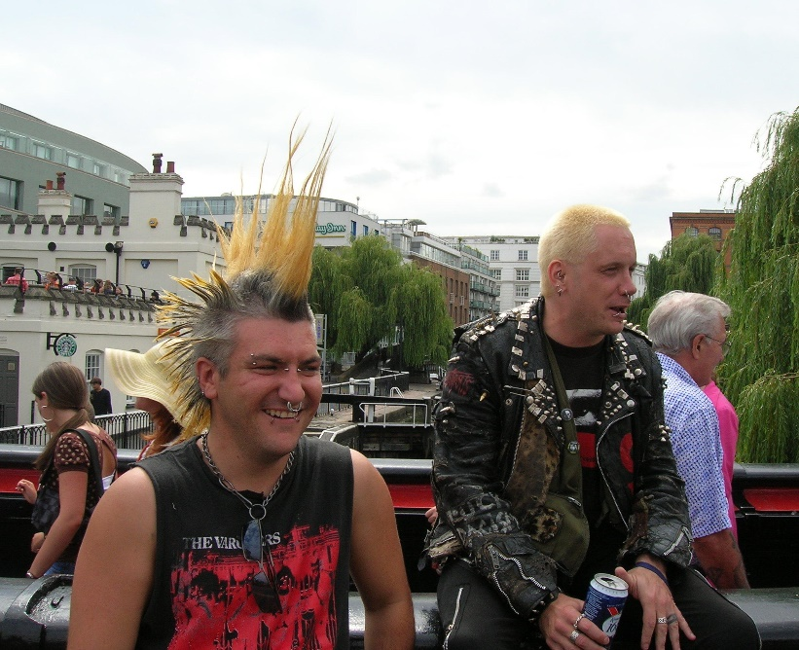

Everyone is Welcome!

Slide 13
Process
Meeting with the Planning Department
Preliminary Review of PUD with the Planning Board
Formal Submission of PUD to the Planning Board
Public Hearing, negotiation, and approval by the Planning Board
Public Hearing, negotiation, and adoption by the Town Council (return to Planning Board if necessary)
New zoning designation of parcel with unique name such as “PUD – Oyster River”
Submission of Site Plan and Subdivision Applications
Review by Planning Board in conformance with approved PUD
The adopted PUD has a fair degree of flexibility so that the site plan may deviate from the adopted PUD to a certain degree. Significant changes require an amendment to the PUD.
Might provide that amendments to PUD are reviewed by the Planning Board and not the Town Council. Might require super majority, like 60% vote, if not go to the Town Council.
A PUD may be extinguished if it is not built upon or if the development stalls. Need provision for the parcel to revert to a regular zoning district. Anything built would be grandfathered if not in conformance with the district.

Slide 14
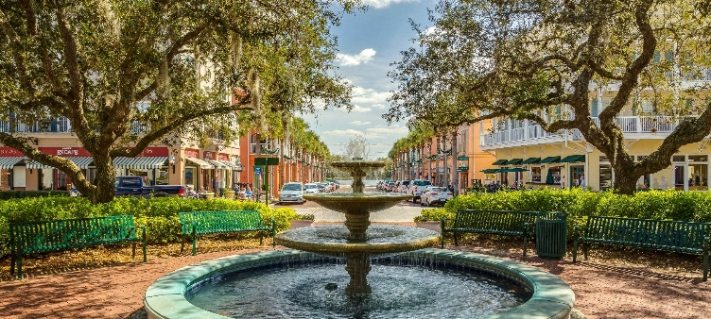
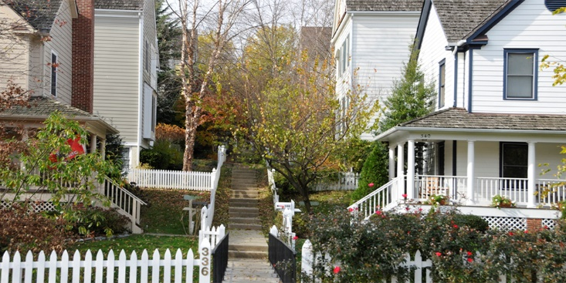
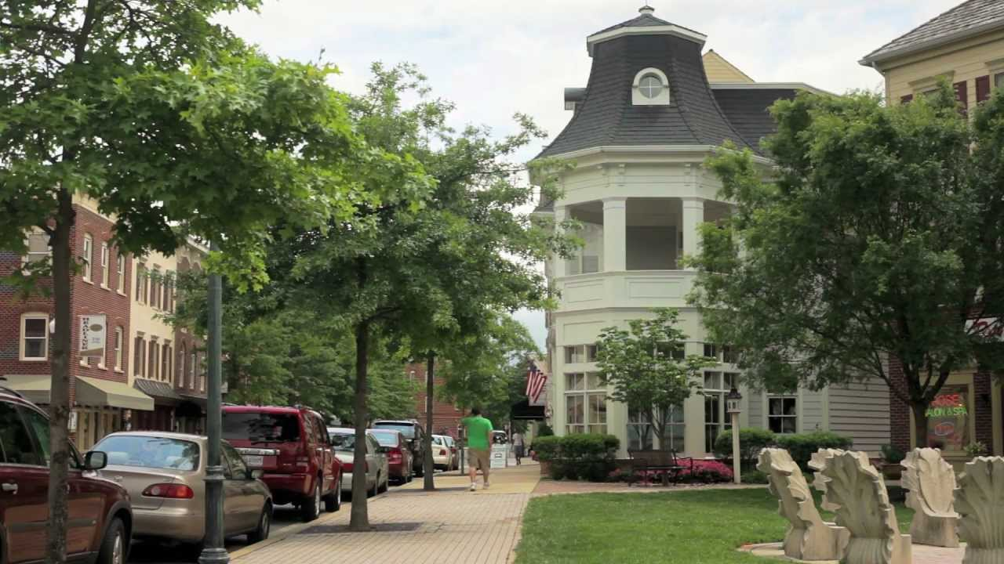
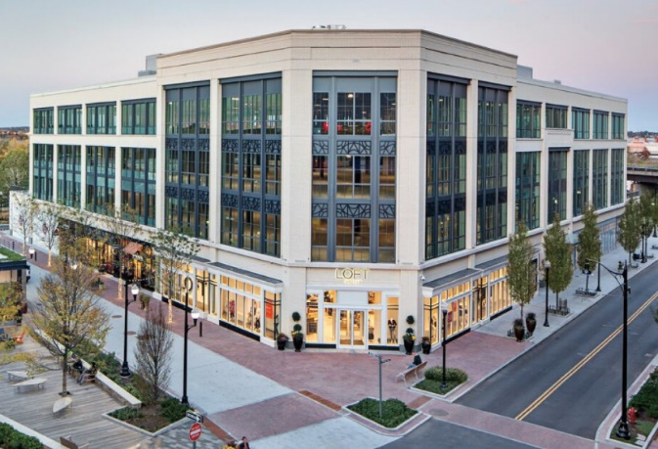
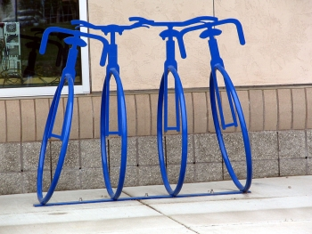
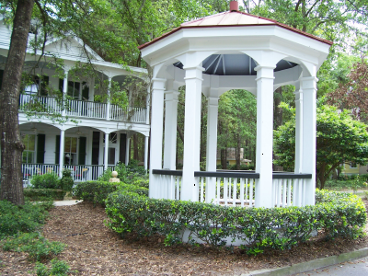
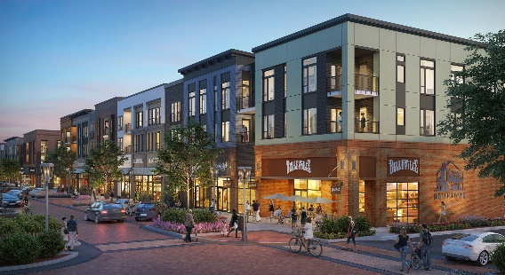
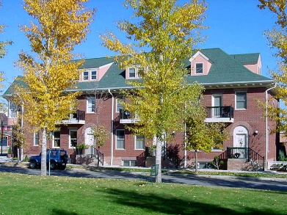
Thank you!

